Slide 1
Artificial Intelligence Laboratory 3: Bayesian Network
DT8012 Halmstad University
Dec 2019

Slide 2
Lab 3
Smart Grid Data
Modelling with Bayesian Network (BN)
Bayesserver
BN modelling software
Picture from Electric Power Distribution Systemhttps://www.nigeriaelectricityhub.com/download/automation-of-electrical-power-distribution-system/

Slide 3
Smart Grid
Power distribution network
Power outage
Predictive maintenance
Failures analysis in the Smart Grid
Picture from Electric Power Distribution Systemhttps://www.nigeriaelectricityhub.com/download/automation-of-electrical-power-distribution-system/

Slide 4
General Objective
Analyse important parameters/factors for failures in the smart grid
Modelling artificial and real data with BN
Learn how to estimate BN parameters
Reasoning and decision making
Working with Bayesserver

Slide 5
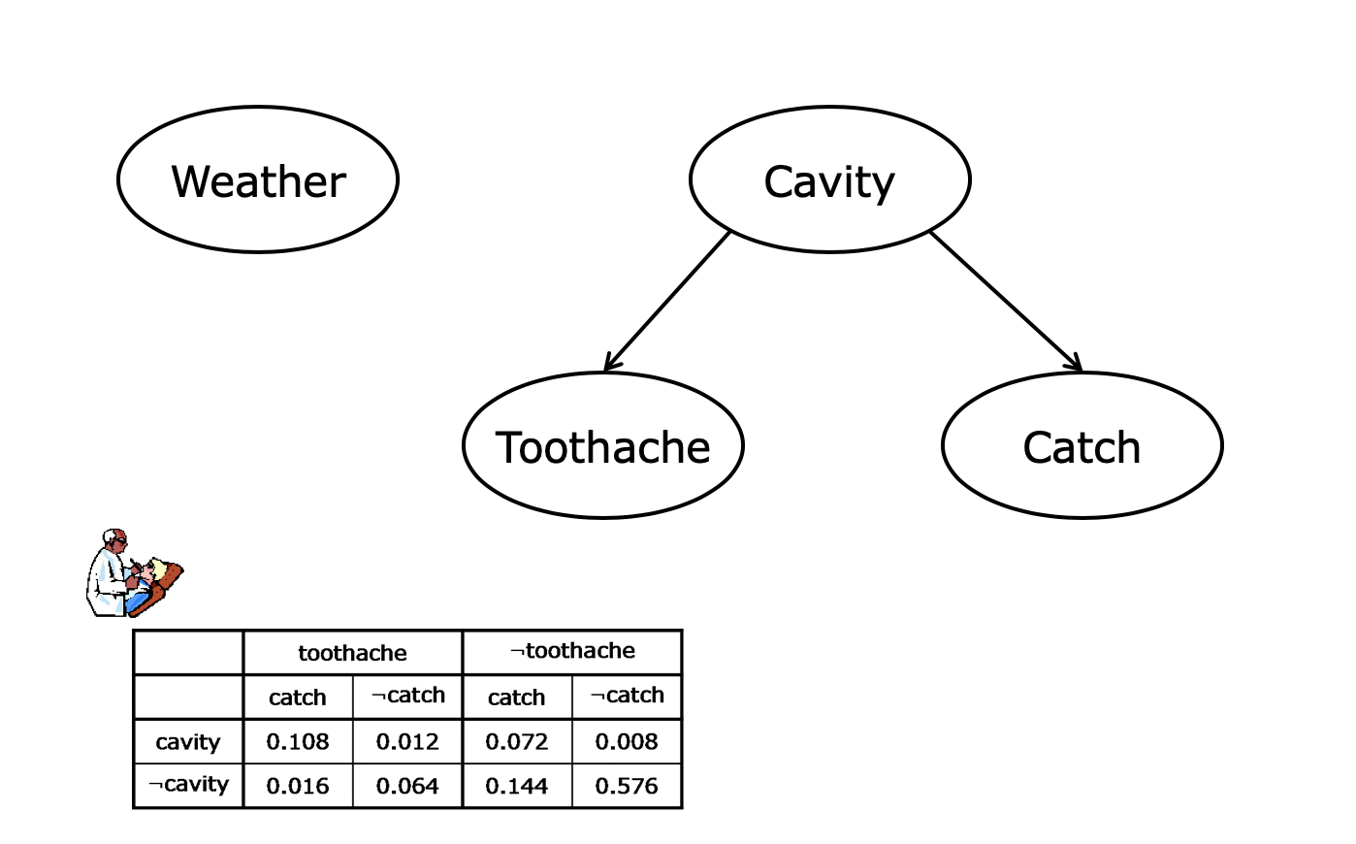
Bayesian networks
A Bayesian network is a directed graph in which each node is annotated with quantitative probability information:
The set of nodes of the network corresponds to a set of random variables {X₁,X₂,X₃,...}
pairs of nodes can be connected by directed links defining a parent → child relation
Each node X_{i} contains a conditional probability distribution P(X_{i} | Parents(X_{i}))
The graph is a directed acyclic graph (DAG)

Slide 6
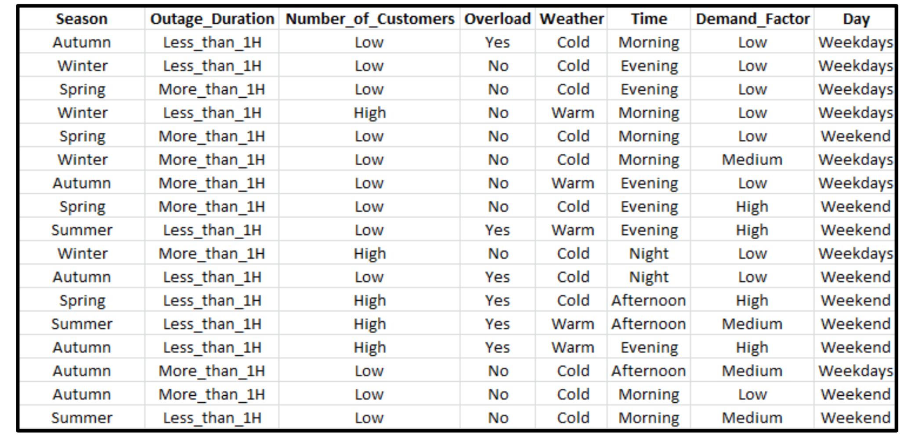
Artificial Data

Slide 7
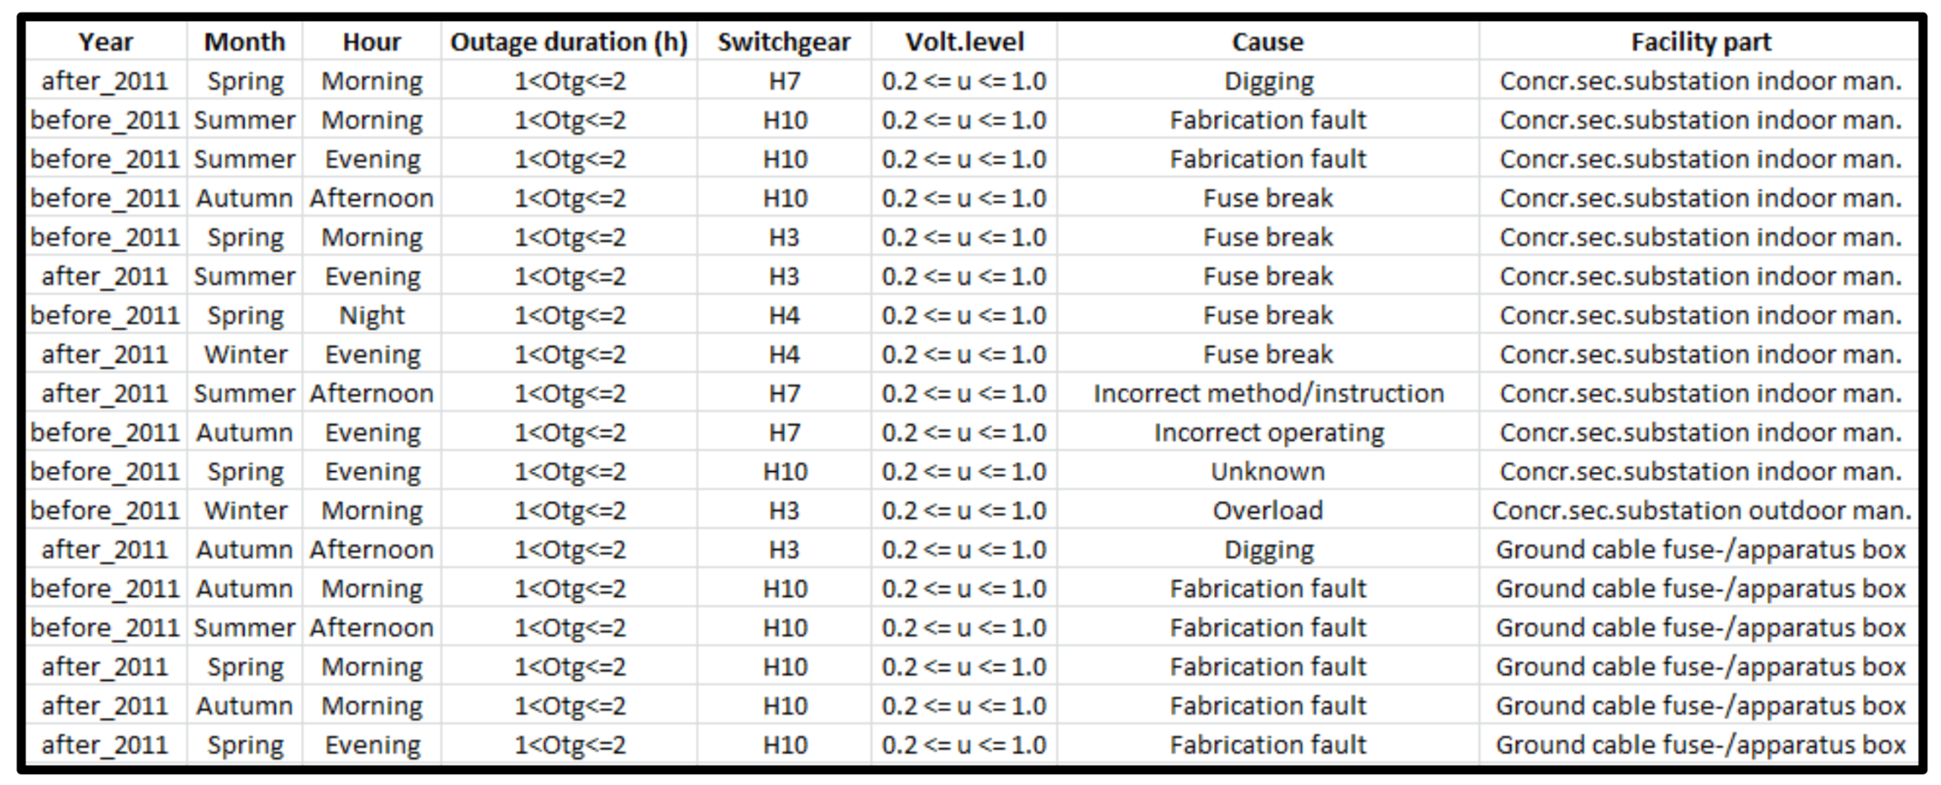
Real Data

Slide 8
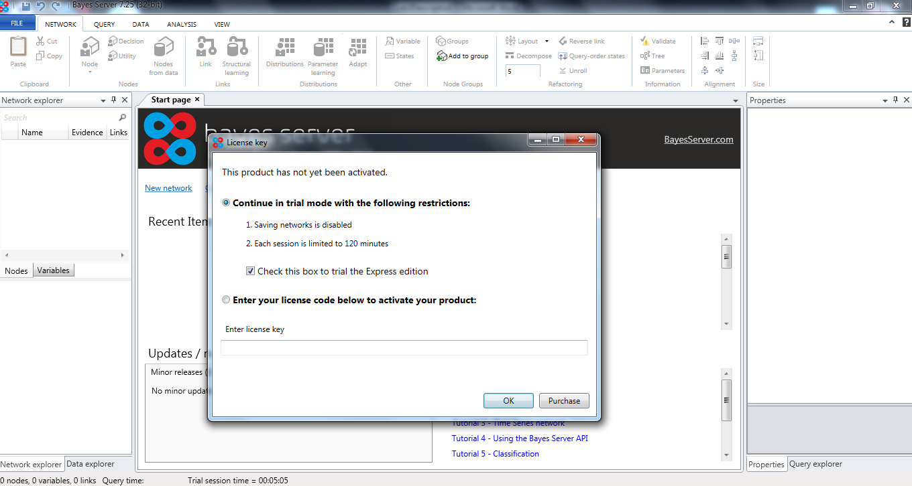
Bayesserver
Network
Data connection
Node
Link
Structural Learning
Algorithms
PC algorithm
Parameter Learning

Slide 9
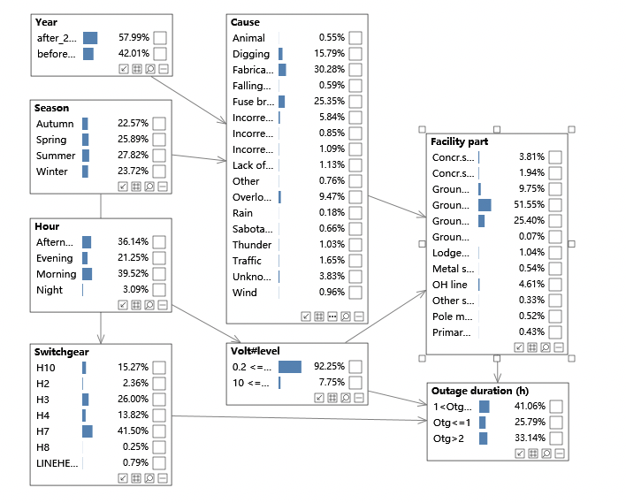
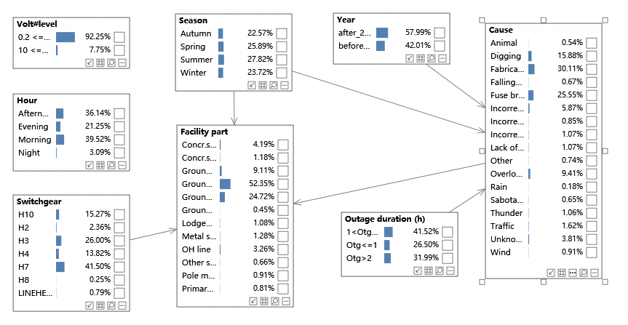
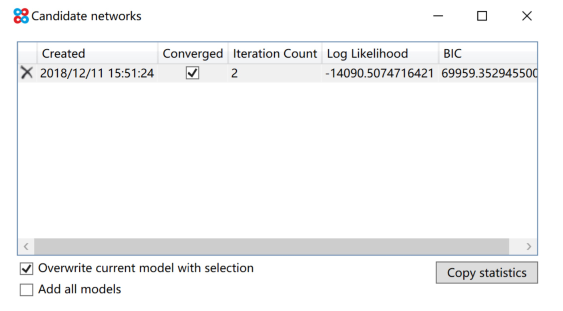
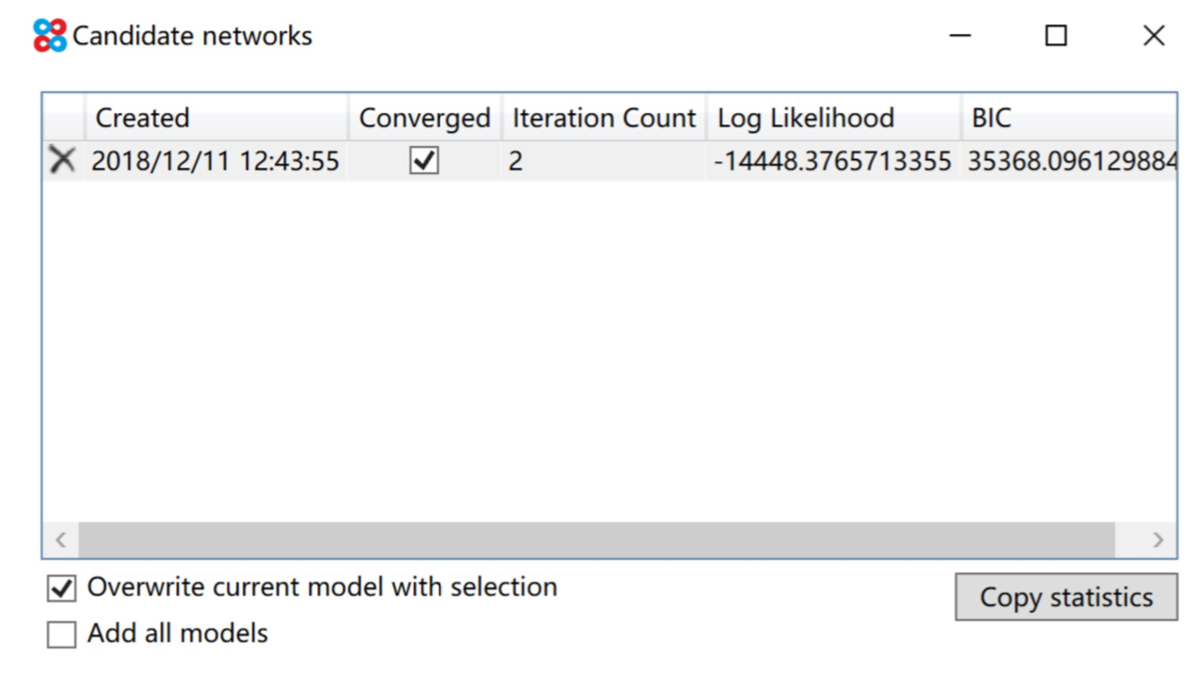
BN examples

Slide 10
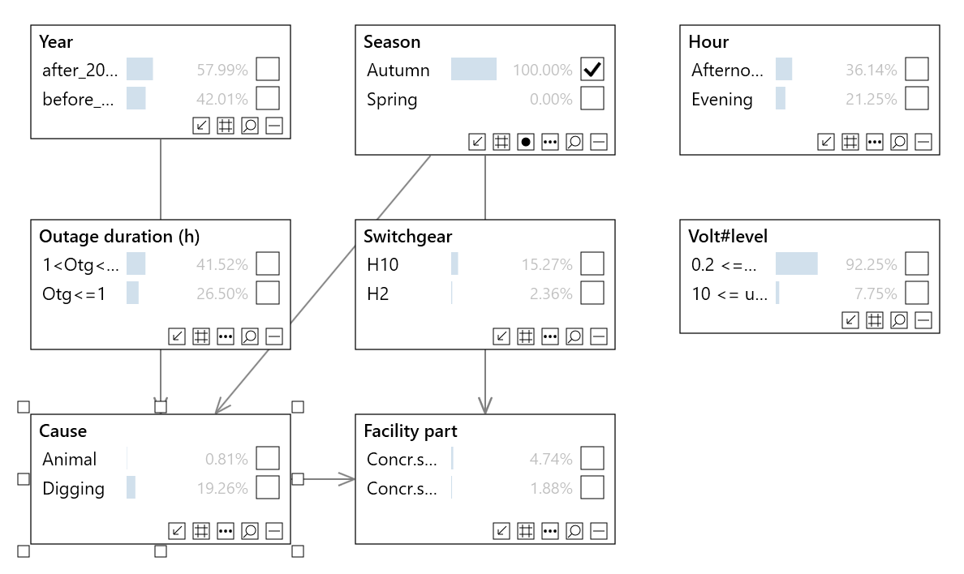
Inference
Exercise:
𝑝(𝐶𝑎𝑢𝑠𝑒 = 𝐴𝑛𝑖𝑚𝑎𝑙 | 𝑆𝑒𝑎𝑠𝑜𝑛 = 𝐴𝑢𝑡𝑢𝑚𝑛) = ?
𝑝(𝑂𝑢𝑡𝑎𝑔𝑒 𝑑𝑢𝑟𝑎𝑡𝑖𝑜𝑛 = 𝑂𝑡𝑔 <= 1 | 𝐹𝑎𝑐𝑖𝑙𝑖𝑡𝑦 𝑝𝑎𝑟𝑡 = 𝐺𝑟𝑜𝑢𝑛𝑑 𝑐𝑎𝑏𝑙𝑒 𝑝𝑖𝑙𝑙𝑎𝑟) = ?

Slide 11
Grading
Submit your assignment on the Blackboard
a short report about what you have done
F505B

